Slide 1
Unified Mentor ARMAN SANI ID-UMIP17332 DATA ANALYST INTERN
DOMAIN - TRAVEL AND TOURISM

Slide 2
ATLIQ HOSPITALITY ANALYSIS

Slide 3
Introduction
PROBLEM STATEMENT
Atliq Grands owns multiple five-star hotels across India. They have been in the hospitality industry for the past 20 years. Due to strategic moves from other competitors and ineffective decision-making in management, Atliq Grands are losing its market share and revenue in the luxury/business hotels category. As a strategic move, the managing director of Atliq Grands wanted to incorporate “Business and Data Intelligence” in order to regain their market share and revenue.
However, they do not have an in-house data analytics team to provide them with these insights. Their revenue management team had decided to hire a 3rd party service provider to provide them with insights from their historical data.

Slide 4
Details of Data
ATLIQ HOSPITALITY INSIGHTS
Total Revenue in 3 months from all the hotels is 1.69 billion and overall average rating is 3.62.
Most Revenue is generated from Mumbai city 660.64 Million.
Least Revenue is generated from Delhi city 290.92 Miilion. In past three months, total booking are 134.59K and occupancy is 57.87%.
Delhi has highest occupancy 60.44% and Average Ratings by 3.62. Hotel Atliq Blue got the highest rating (3.96) among others. Hotel Atliq Seasons has got lowest ratings (2.30) among others hotel.
Maximum revenue generated among room categories by Elite (RT2) by 553.74 Million.
May is the month with highest revenue followed by June and July.
Weekends consistently exhibit higher occupancy rates than weekdays.
Other travel platforms / channels are primary booking source, generating 41% of total bookings and revenue. Direct offline booking contributes the least to bookings and revenue generation, with 5%.
The Luxury room category contributes the majority of revenue and bookings. Mumbai city contributes most of the revenue, followed by Hyderabad, Bangalore and Delhi.

Slide 5
Recommendations
Atliq Grands can enhance revenue generation by harnessing dynamic pricing strategies, particulary by adjusting prices upwards during peak days and weekends wgen demand is high.
To increase bookings and revenue on offline booking platforms, Atliq Grands should explore differential pricing strategies. This involves launching targeted marketing campaigns and promotions to attract customers, potentially from a different segment.
Reducing reliance on third-party online platforms can be achieved by exploring opportunities to direct bookings through the hotel's website. Atliq Grands may consider offering incentives, exclusive promotions, or benefits to encourage customers to book directly, thereby saving on commission fees.

Slide 6
Main KPIs
TOTAL REVENUE: $1.69 BILLION IN 3 MONTHS
OVERALL AVERAGE RATING: 3.62
HIGHEST REVENUE: MUMBAI - $660.64 MILLION LOWEST REVENUE: DELHI - $290.92 MILLION TOTAL BOOKINGS: 134.59K IN 3 MONTHS OCCUPANCY RATE: 57.87%
HIGHEST OCCUPANCY: DELHI - 60.44%
AVERAGE RATINGS: 3.62
HIGHEST RATED HOTEL: ATLIQ BLUE - 3.96
LOWEST RATED HOTEL: ATLIQ SEASONS - 2.30
MAXIMUM REVENUE FROM ROOM CATEGORY ELITE (RT2): $553.74 MILLION.

Slide 7
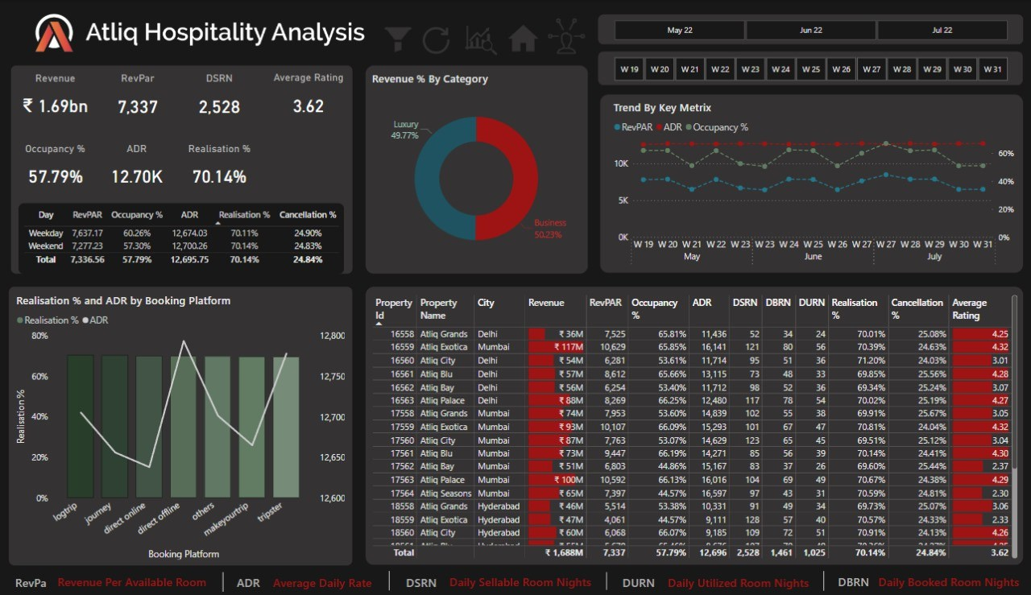
Mock – up Dashboard

Slide 8
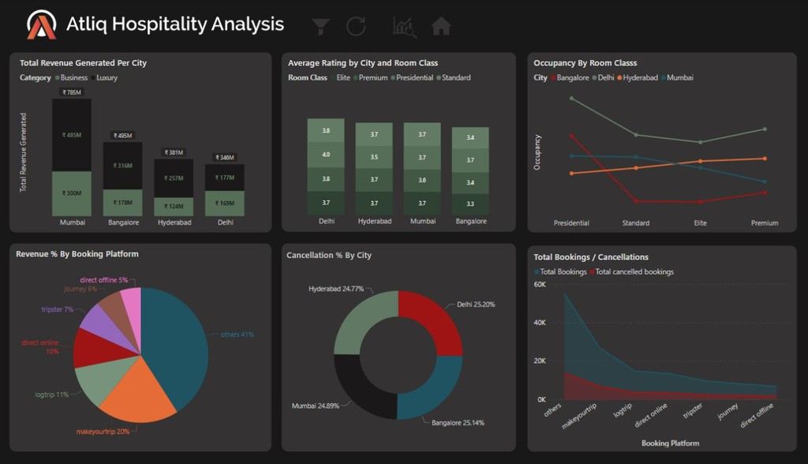
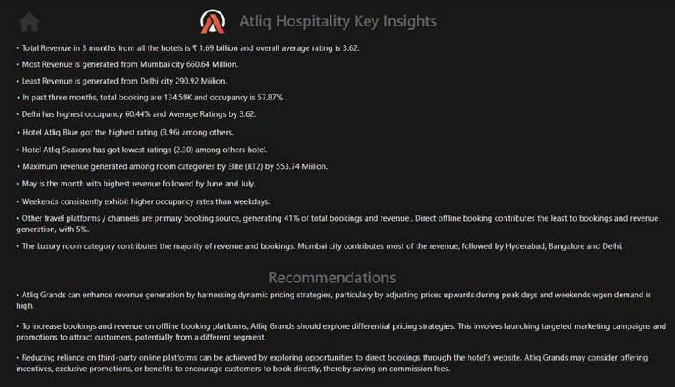
MY DESIGN

Slide 9
THANK YOU

